Slide 1
2024 Summer Course
Week 2 (08/07) - PyTorch
Presenter: Ming-Yiao, Chen

Slide 2
Outline
Traning Environment
Anaconda/Miniconda
Kaggle
PyTorch Introduction
Example
Homework

Slide 3


Windows
Download Link: https://www.anaconda.com/download/success
Click
Run Anaconda3-YYYY.MM-?-Windows-??????.exe
Next -> I Agree -> Next -> Next -> Install -> Next -> Next -> Finish

Slide 4
Linux
Installing on Linux: https://docs.anaconda.com/anaconda/install/linux/
Follow the steps
Warning
Please replace <INSTALLER_VERSION> to which version you downloaded.
Please replace <PATH_TO_CONDA> to where you installed anaconda3.

Slide 5
Miniconda
Windows
Open Terminal
Follow below steps:
curl https://repo.anaconda.com/miniconda/Miniconda3-latest-Windows-x86_64.exe -o miniconda.exe start /wait "" miniconda.exe /S del miniconda.exe
Open Anaconda Prompt (miniconda3)

Slide 6
Miniconda
Linux
Open Terminal
Follow below steps:
mkdir -p ~/miniconda3 wget https://repo.anaconda.com/miniconda/Miniconda3-latest-Linux-x86_64.sh -O ~/miniconda3/miniconda.sh bash ~/miniconda3/miniconda.sh -b -u -p ~/miniconda3 rm -rf ~/miniconda3/miniconda.sh ~/miniconda3/bin/conda init bash
Restart Terminal

Slide 7
Install Packages for Training
Open Anaconda Prompt (Windows) / Terminal (Linux)
Create new environment
conda create -n summercourse python=3.8
Activate environment
conda activate summercourse
Install packages
conda install anaconda::pillow (recommand)
pip install pandas
…

Slide 8
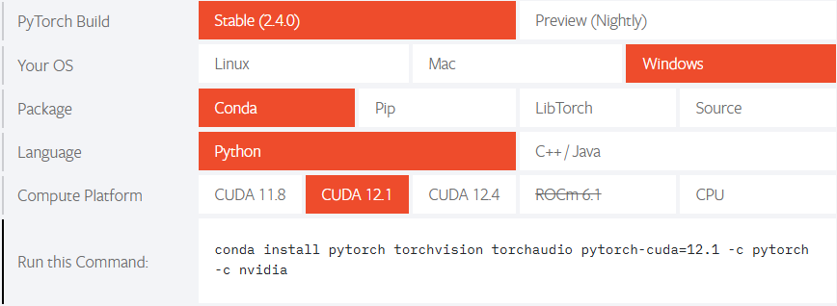
Install PyTorch
PyTorch Official Website: https://pytorch.org/

Slide 9
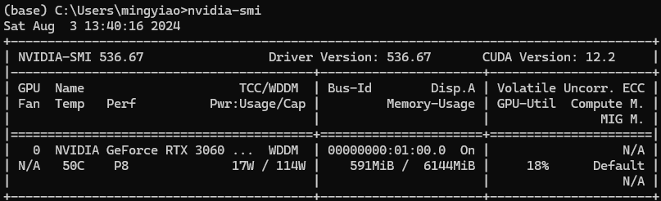
Install PyTorch
How to check CUDA version?

Slide 10
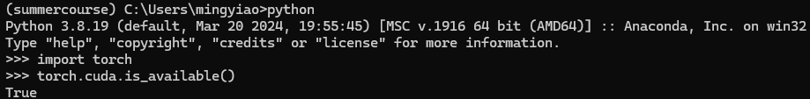
Install PyTorch
Check CUDA is available with pytorch.

Slide 11

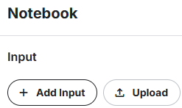
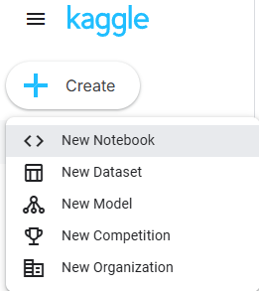
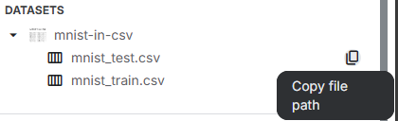

Kaggle Official Website: https://www.kaggle.com/

Slide 12
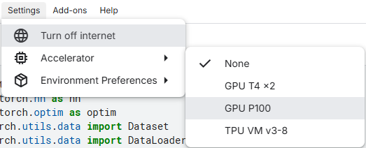



Slide 13
Training a model with PyTorch
Use week 1 homework as an example.
Please open this link
https://github.com/ZackChen1140/SummerCourse2024/blob/main/week1/MNISTClassification.ipynb

Slide 14
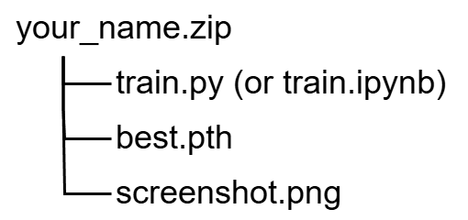
Homework
Please train a model with PyTorch to classify Fashion MNIST dataset, and submit your source code for training, your best model, and the screenshot of the training log (not required if your jupyter notebook contains the training log).
Your source code must contain custom dataset, data normalization ,data augmentation, loss&accuracy calculations on training/validation/testing set.
Deadline: 2024/08/13 23:99:99
Folder Structure:

